Slide 1
Global PSP Project for Indian Embassies and Consulates
Quick Guide – Changing Photograph/Signature Image Post Granting (PIA → EO → PIA → Printing)

Slide 2
Login Using PIA Role to Initiate Photo/Signature Change Process through Change Applicant Details Link

Slide 3
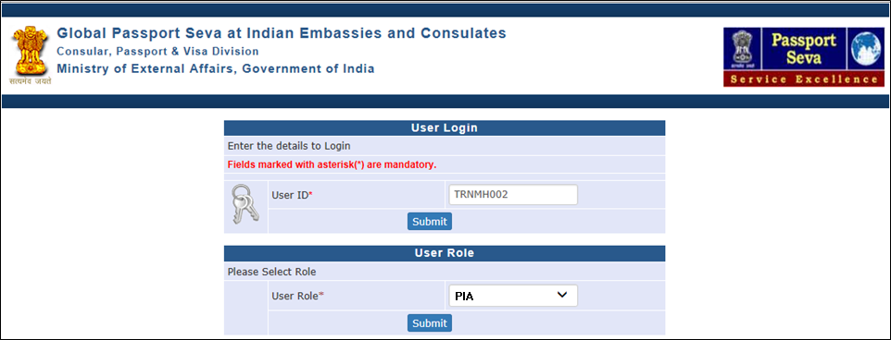
Login Using User ID, Password, and Grid Values
Visit Global PSP Office Portal (https://embassy.passportindia.gov.in)
Enter User ID
Press Submit button
Choose User Role as ‘PIA’
Press Submit button displayed below the User Role

Slide 4
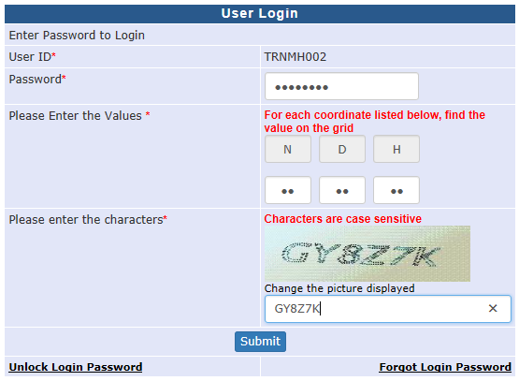
Login Using User ID, Password, and Grid Values (continued..)
Enter Password
Check your User Grid and enter the values for the three alphabets displayed on the screen
Enter the characters displayed in the CAPTCHA image
Press Submit button

Slide 5
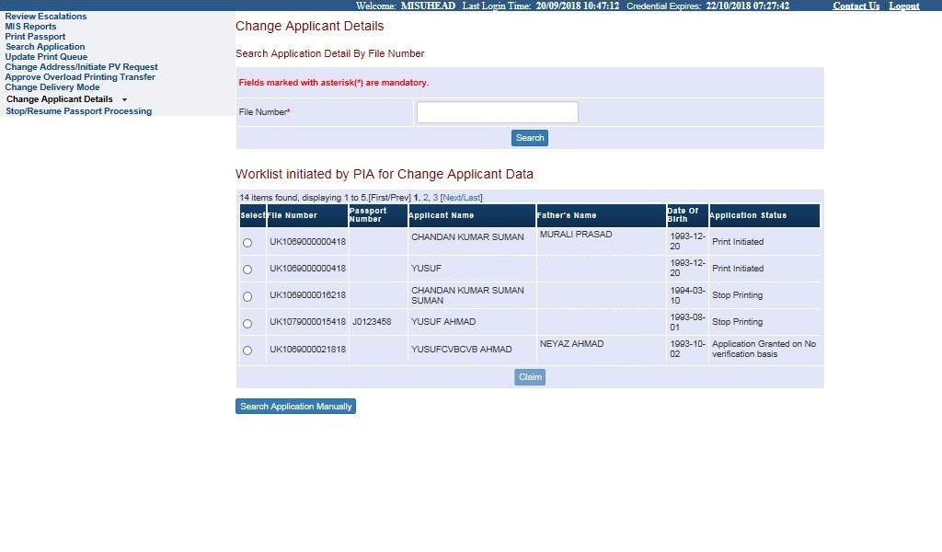
Change Applicant Details
Click on the link ‘Change Applicant Details’
Worklist of cases sent for data modification by Print Operators or as part of Reviewing Cancellation of QC Rejection cases, imposition of stop for data modification/other reasons, cases pulled back/sent back from CPPF and so on is displayed in the screen in form of worklist.
Select the file from the work list, or type the file number and search the file from the worklist and press claim button

Slide 6
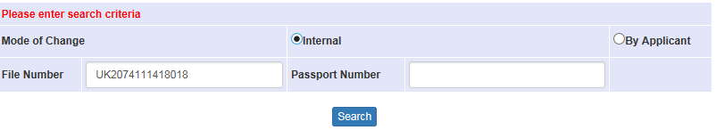
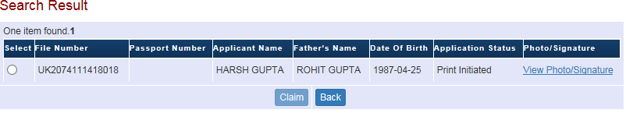
Change Applicant Details - Search Application Manually
Press the ‘Search Application Manually’ button if the desired file number is not visible in the worklist
Select ‘Mode of Change’ from either of the following values
By Applicant: For cases where applicant has requested reprinting of passport with correction in data after the same was issued to him/her
Internal: For data correction needs identified internally for not yet issued passport applications
Enter File Number or Passport Number and Click on Search Button

Slide 7
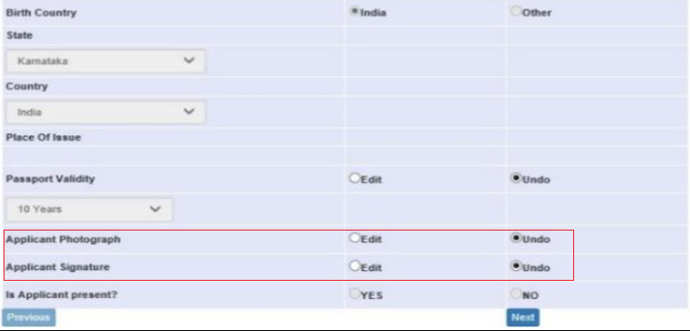
Change Applicant Details (Continue..)
After claiming the file through worklist or through manual search, user is displayed multiple pages of the various passport printable details. User may choose “Edit” option to make changes in a specific field, if required
Choose “Edit” in Applicant Photograph and/or Applicant Signature fields in case any change is required in Photograph and/or Signature respectively

Slide 8
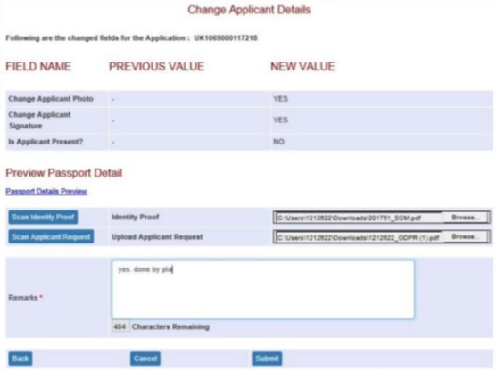
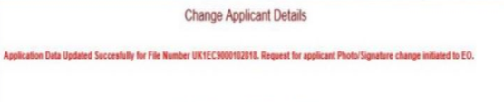
Change Applicant Details (Continue..)
Confirm the previous value and new value for the changed passport printable data fields
Check the updated Passport Preview Details using the hyperlink ‘Passport Details Preview’
Enter proper remarks and press Submit button to initiate the Photo/Signature Change (by EO) Process

Slide 9
Login Using EO Role to Execute Photo/Signature Change Process Initiated by PIA

Slide 10
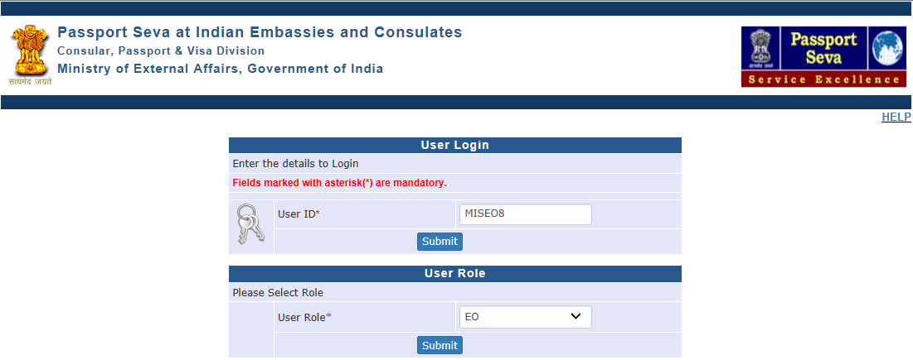
Login Using User ID, Password, and Grid Values
Visit Global PSP Office Portal (https://embassy.passportindia.gov.in)
Enter User ID
Press Submit button
Choose User Role as ‘EO’
Press Submit button displayed below the User Role

Slide 11
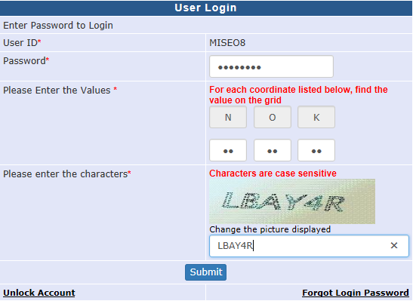
Login Using User ID, Password, and Grid Values (continued..)
Enter Password
Check your User Grid and enter the values for the three alphabets displayed on the screen
Enter the characters displayed in the CAPTCHA image
Press Submit button

Slide 12
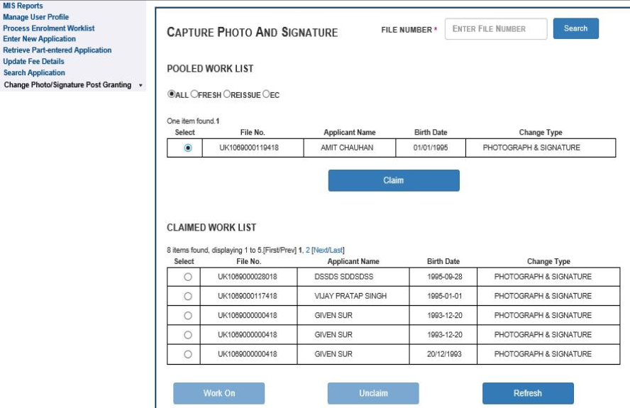
Change Photo/Signature Post Granting
Click on Change Photo/Signature Post Granting link
Claim the desired work-item from the worklist and click on the Work On button to process the photo/signature change

Slide 13
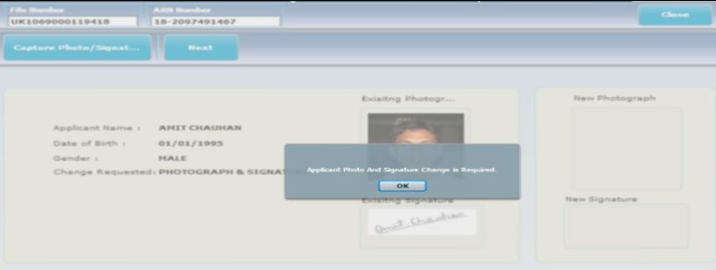
Change Photo/Signature Post Granting (continued..)
File Number, ARN Number, Applicant Name, Date of Birth, Gender and details of required action (that is, change of photo and/or signature) is displayed on screen

Slide 14
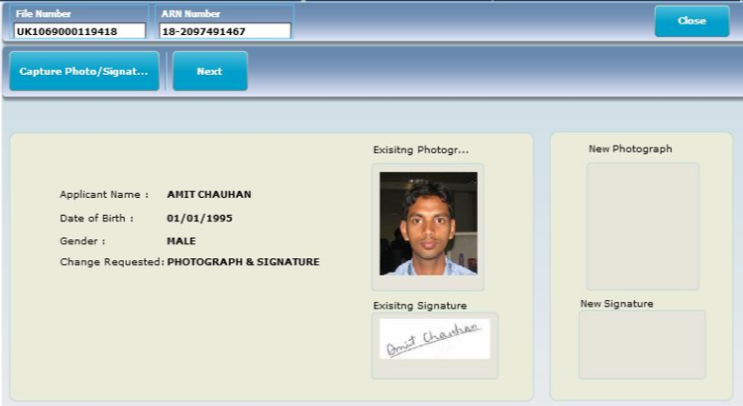
Change Photo/Signature Post Granting (continued..)
File Number, ARN Number, Applicant Name, Date of Birth, Gender and details of required action (that is, change of photo and/or signature) is displayed on screen
Click on Capture Photo/Signature button to open the sub-screen for capturing new photograph and/or signature

Slide 15
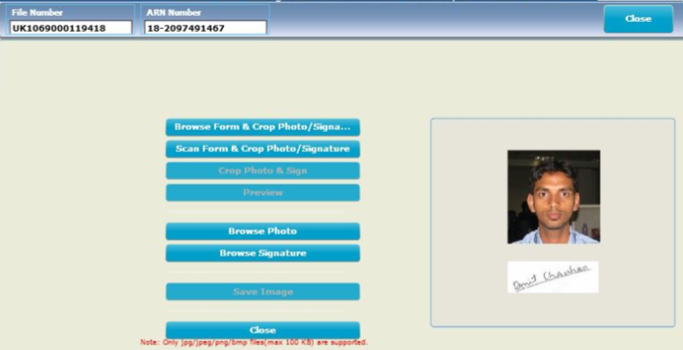
Change Photo/Signature Post Granting (continued..)
All standard photograph/signature capturing options, as available in EO users’ Process Enrolment Worklist screen, are available. Thereby, Photo and Signature can be uploaded in multiple ways (directly browse & upload the image / browse form & crop image / scan form & crop image)
Save the changes after uploading/cropping the new images

Slide 16
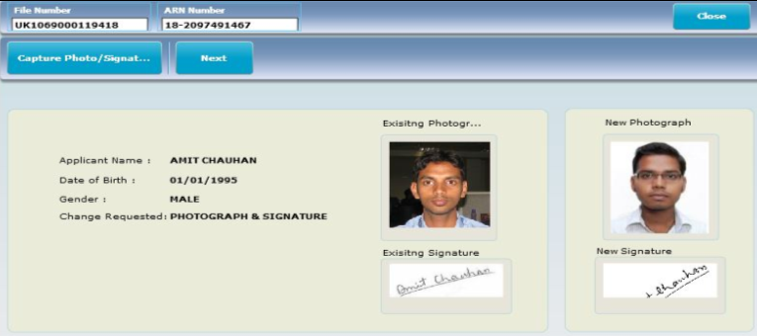
Change Photo/Signature Post Granting (continued..)
Once the photo/signature image changes are saved, system displays the old and new images side-by-side for a quick comparison
Click Next to go ahead for viewing the Passport/Travel Document Preview (with new images) or click on Capture Photo/Signature button again to recapture the image(s)

Slide 17
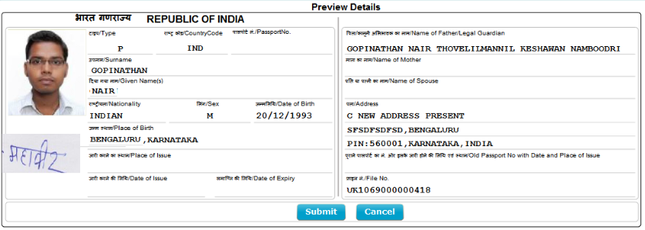
Change Photo/Signature Post Granting (continued..)
After reviewing the Passport/Travel Document Print Preview details - click Submit button to go ahead for entering remarks before finally submitting the changes for PIA review. Else, click Cancel to go back and make further corrections in the captured image(s)

Slide 18
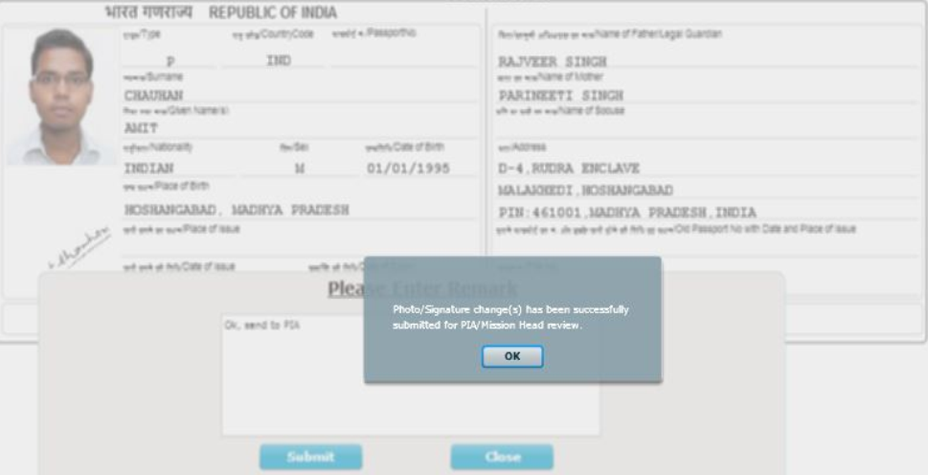
Change Photo/Signature Post Granting (continued..)
Enter due remarks (up to 150 characters long) and click on Submit button to submit the changes for PIA review.
Success message will be displayed to confirm successful submission of the changes for PIA review

Slide 19
Login Using PIA Role to Review the Photo/Signature Changes Done by the EO Users

Slide 20
Login Using User ID, Password, and Grid Values
Visit Global PSP Office Portal (https://embassy.passportindia.gov.in)
Enter User ID
Press Submit button
Choose User Role as ‘PIA’
Press Submit button displayed below the User Role

Slide 21
Login Using User ID, Password, and Grid Values (continued..)
Enter Password
Check your User Grid and enter the values for the three alphabets displayed on the screen
Enter the characters displayed in the CAPTCHA image
Press Submit button

Slide 22
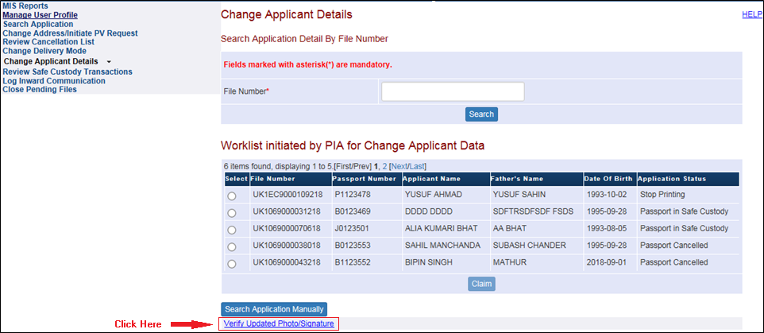
Change Applicant Details → Verify Updated Photo/Signature
Click on the link ‘Change Applicant Details’
Click on the hyperlink ‘Verify Updated Photo/Signature’ to view the work list of photo/signature change cases pending for PIA review
Select the file from the Pooled or Claimed work list, or type the file number and search the file from the worklist and press claim button

Slide 23
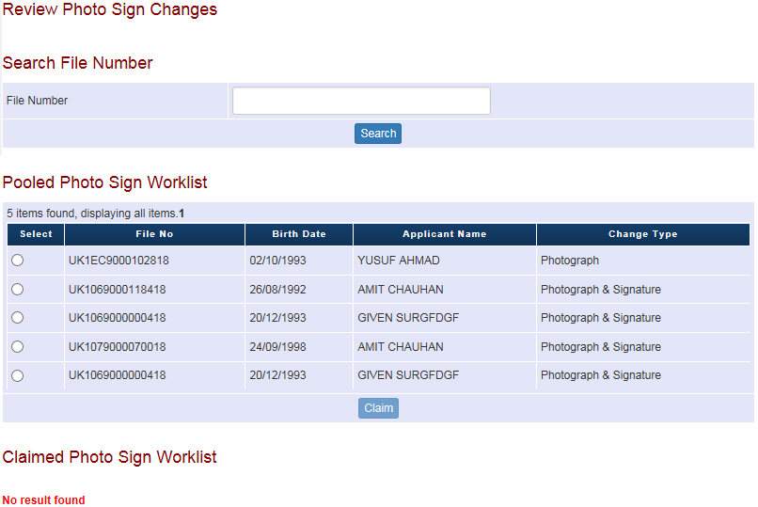
Change Applicant Details → Verify Updated Photo/Signature (continued…)
Select the file from the Pooled or Claimed work list, or type the File Number and search the file from the worklist and press Claim button

Slide 24
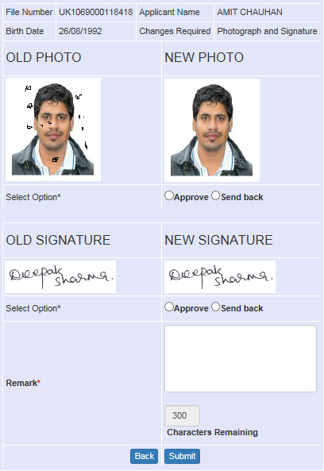
Change Applicant Details → Verify Updated Photo/Signature (continued…)
Old and New images for Applicant Photograph and Signature are displayed. (Click Approve, enter Remarks and press Submit button to reflect the changes in the system. Else, click Send Back, enter Remarks and press Submit button to send back the case to EO for re-capturing the photo/signature image(s) as required.)

Slide 25
In case of additional information or clarification, please contact Global PSP Support Team at
Email : global.psp@tcs.com
Phone : +91-0120-672-9595/96
Mobile : +91-730-351-9595
Thank You

